Slide 1

DEPARTMENT OF COMPUTER SCIENCE AND ENGINEERING
Project name : Smart Water System
Team name : Proj_22478_Team_2
Team members :
Pokala Deepika(113321104075)
Rekha RD(113321104081)
Sahana S(113321104082)
Samyuktha J(113321104083)

Slide 2
OBJECTIVES:
The project involves implementing IoT sensors to monitor water consumption in public places such as parks and gardens. The objective is to promote water conservation by making real-time water consumption data publicly available.
This project includes defining objectives,designing IoT sensor system developing the data sharing platform and integrating them using IoT technology and python.

Slide 3
ENHANCING SMART WATER SYSTEM USING IOT SENSORS:
Real-time Monitoring: IoT sensors can continuously monitor water quality, flow rates, and levels, allowing for immediate detection of issues like leaks or contamination.
Data Collection: These sensors collect data and send it to a central system, enabling data-driven decisions for efficient water management.
Remote Control: IoT technology allows you to remotely control valves and pumps, optimizing water distribution and reducing waste.
Predictive Maintenance: Sensors can predict equipment failures, minimizing downtime and maintenance costs.

Slide 4
REAL TIME INFORMATION ABOUT SMART WATER
IoT Sensors and Devices:
Deploy a network of IoT sensors and devices throughout the water distribution network, including water treatment plants, reservoirs, pipelines, and consumer premises.
These sensors will continuously monitor parameters such as water flow rate, pressure, temperature, pH levels, turbidity, and contaminants.
Real-time Data Collection:
Collect real-time data from the sensors and devices, providing a comprehensive view of the entire water system's status.
Use wireless communication protocols (e.g., LoRaWAN, NB-IoT) to transmit data securely and efficiently.

Slide 5
IoT SENSOR DESIGN:
There are several IoT sensors and components that are used in the smart water system using IoT. Some of them are as follows.
1.Ultrasonic sensor: It is used to indicate the level of water in real time. When the water level falls below the threshold level the motor will automatically ON.
2. Temperature sensor: It is used to sense the temperature in water tank.
3. Water flow Sensor: It is used to know the usage of water litre per hour. By using ESP8266 WI-FI module the data is recorded in real-time and updated in cloud.

Slide 6
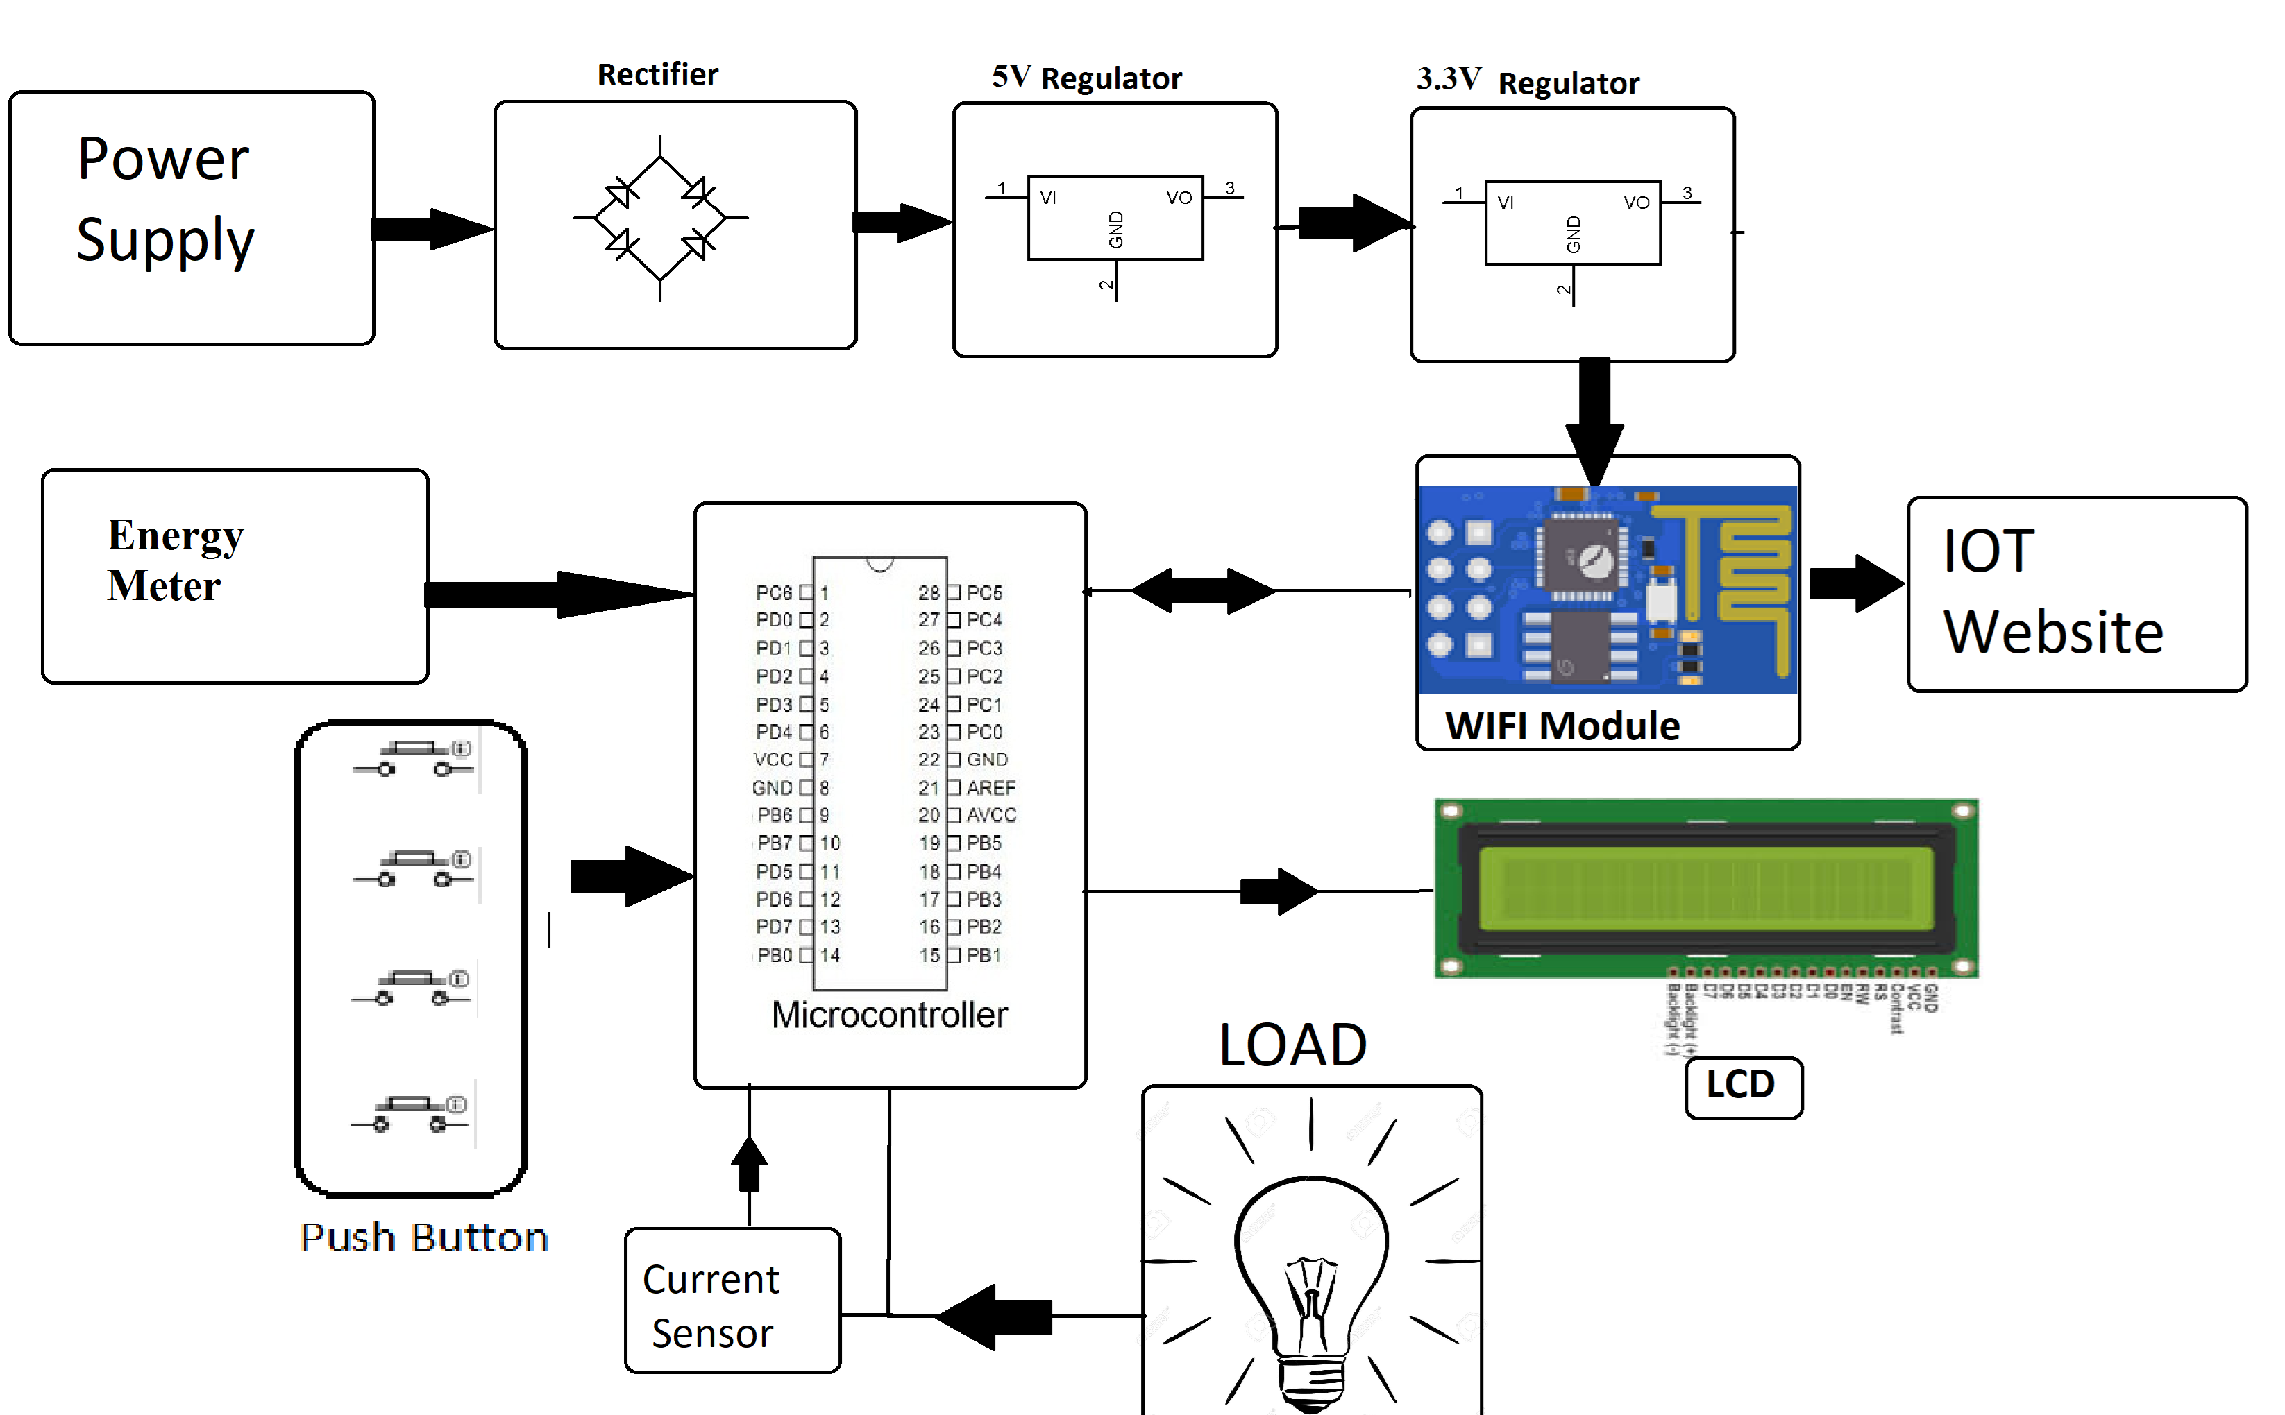

Slide 7
INTEGRATING SMART WATER SYSTEM USING IOT AND PYTHON
Data Analytics: Implement data analytics and visualization using Python libraries such as Matplotlib, Plotly, or Dash to gain insights from your water system data.
Alerts and Notifications: Set up alerts and notifications in Python to trigger actions when specific conditions are met (e.g., sending alerts for leak detection).
Install Sensors: Physically install the selected sensors at strategic locations within your water system, such as near water sources, in pipelines, or at distribution points.
Connect Sensors: Use communication protocols such as Wi-Fi, Bluetooth, LoRa, or cellular networks to connect the sensors to a central data hub. Python libraries or SDKs may be available for specific IoT hardware to facilitate this connectivity.4.

Slide 8
THANK YOU

